Slide 1
Carbon Monitoring of Agricultural Lands: Developing a Globally Consistent Estimate of Carbon Stocks and Fluxes
Julie Wolf¹, Stephen Ogle² and Tris West¹
¹Joint Global Change Research Institute
²Natural Resource Ecology Laboratory, CSU
CMS 2014 Science Team Meeting
Notes:
2013 project

Slide 2
Objectives:
Our 2012 project quantified global agricultural carbon fluxes in detail, excluding soil carbon:
Notes:
carbon is fixed by crop plants and a lot of that decomposes in place to return to the atmosphere as CO2. here we track those carbon fluxes, as well as the transport and consumption of carbon in harvested material. we also estimate how much carbon is brought into the agricultural system from non-crop lands by livestock foraging, i.e. grazing

Slide 3
Objectives:
Complete spatially resolved global agricultural carbon budget.

Slide 4
Objectives:
Complete spatially resolved global agricultural carbon budget.
  Quantify and spatially distribute changes in soil carbon on global agricultural lands
  Quantify and distribute grassland productivity and consumption through livestock grazing

Slide 5
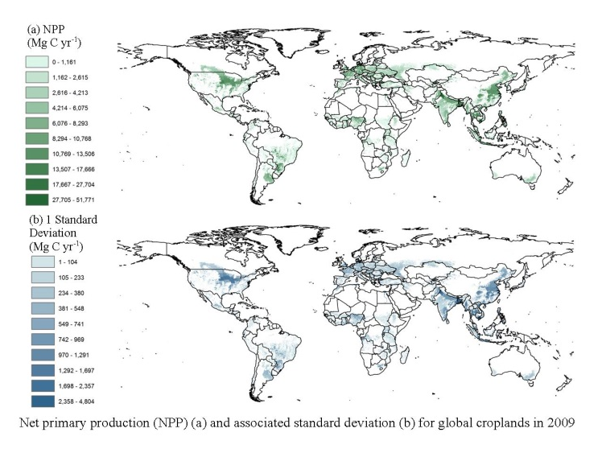
From 2012 project:
Crop NPP components distributed spatially at 0.05°
Notes:
Recall that our completed 2012 project has detailed crop and livestock fluxes distributed spatially

Slide 6
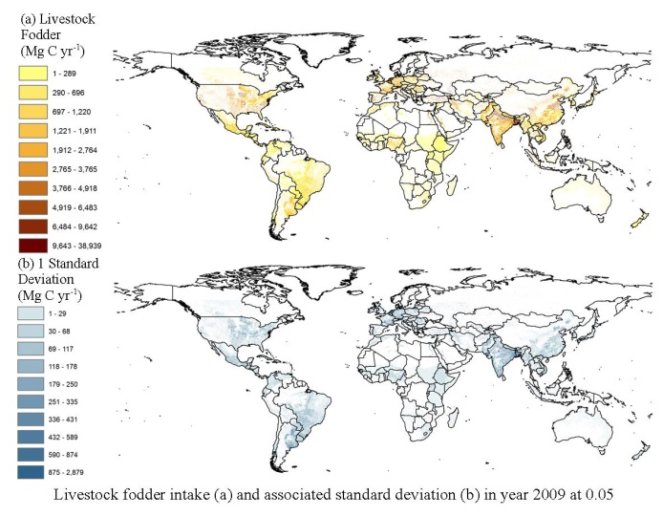
From 2012 project:
Livestock flux components distributed spatially at 0.05°
Notes:
Recall that our completed 2012 project has detailed crop and livestock fluxes distributed spatially

Slide 7
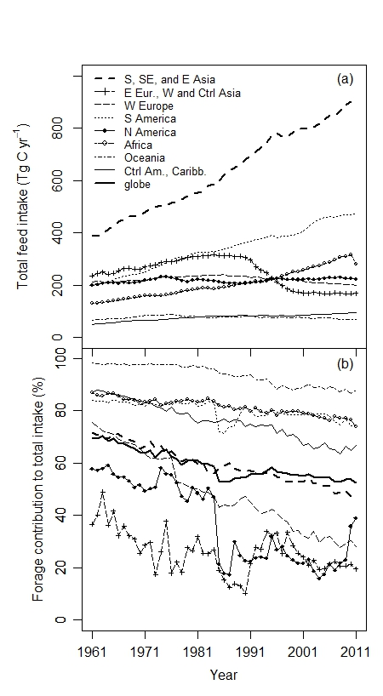
From 2012 project:
Detailed livestock intake (top panel)
and percent intake from forage/grazing (lower panel)
Notes:
if you recall, in our first project we developed detailed agricultural carbon budget, including

Slide 8
Objectives:
Complete spatially resolved global agricultural carbon budget.
  Quantify and spatially distribute annual changes in soil carbon on global agricultural lands
  Quantify and distribute grassland productivity and consumption through livestock grazing
Build on previous results.
Notes:
the results from our first project will allow us to complete a spatially resolved, global agricultural carbon budget. what is still needed is change in soil carbon and an accounting of carbon brought into ag through grazing.

Slide 9
Methods:
1. Global agricultural soil carbon:
Model change and uncertainty at 0.05 degree resolution for recent 5-year periods
Simplified crop-specific Century-like model
Builds off of recent EPA-funded study soil carbon change led by Stephen Ogle.
Notes:
Texture from HWSD, temp and precip from CRU (climatic research unit)

Slide 10
Methods:
1. Global agricultural soil carbon:
Previous results drive model:
  Gridded crop NPP
  Crop residue left on field
  Crop belowground biomass
  Nitrogen and lignin contents of crop biomass
  Manure application to agricultural lands
Along with:
  Soil texture (HWSD)
  Temperature and precipitation (CRU)
  Irrigation (MIRCA 2000)
  Tillage practices
Notes:
Texture from HWSD, temp and precip from CRU (climatic research unit)

Slide 11
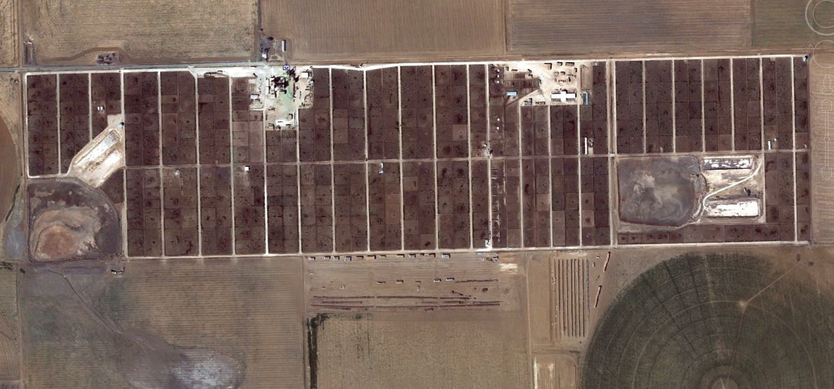
Methods:
  Manure application to agricultural lands
Notes:
Manure application is problematic, both because large proportions of C and N lost during manure ‘management’, but also because we don’t know where manure is being overapplied and where none is applied….

Slide 12
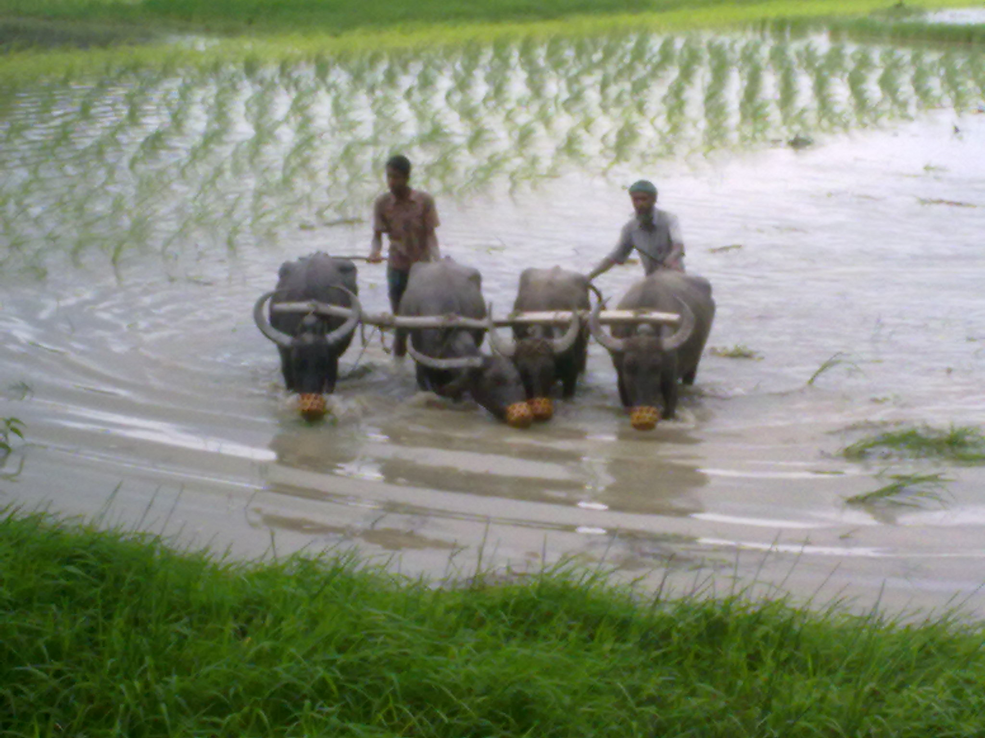
Methods:
  Manure application to agricultural lands
Notes:
And when we do global projects, we have to understand practices in all parts of the globe.

Slide 13
Methods:
2. Grassland productivity and consumption:
Model global grassland productivity at 0.05° based on mean precipitation
Combine with our estimates of livestock forage intake so that grazed lands can be included in agricultural budgets
Notes:
This is based on findings reported by Del Grosso, Parton, et al. in 2008. “preliminary work”. Show gridded manure map or similar, and discuss. Where is estimate coming from? I have to create that. ‘grazing is poorly understood’, this is a big uncertainty. And also a big amount—show some result. Expand to show how we will use total livestock forage requirement to estimate what is taken off.

Slide 14
Significance:
Consistent with Tier 3 IPCC global soil carbon change guidelines, but with:
  Better inputs
  finer spatial resolution
  Improved uncertainty estimates
  Global coverage
Fills gap for our flux product and provides globally consistent soil carbon change estimates for all agricultural lands.

Slide 15
Significance:
By quantifying
  cropland soil carbon change and
  grassland carbon fluxes
we complete agricultural carbon budgets and generate comprehensive agricultural flux estimates.
Project is ongoing.

Slide 16
Thank you.
Notes:
results from similar modeling done

Slide 17
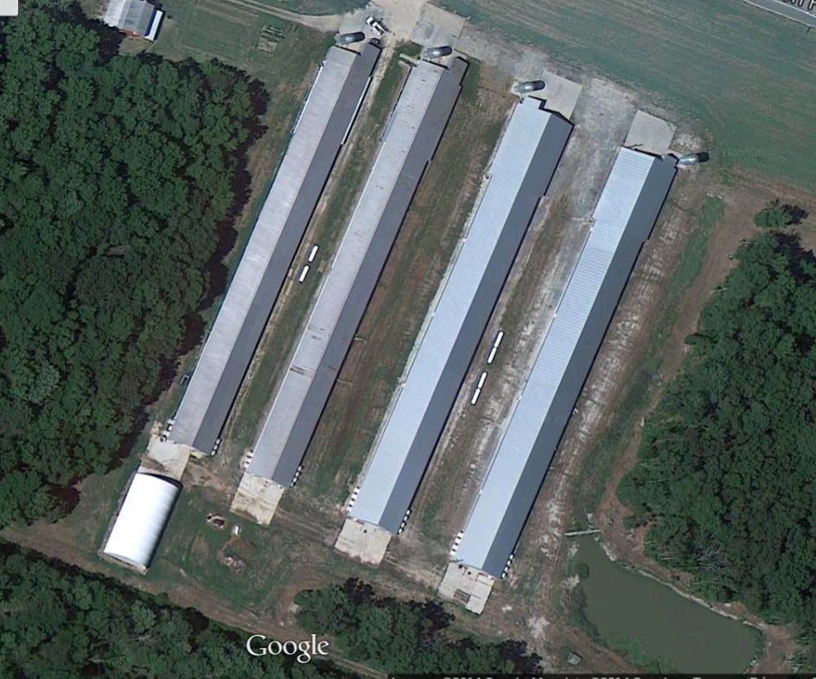
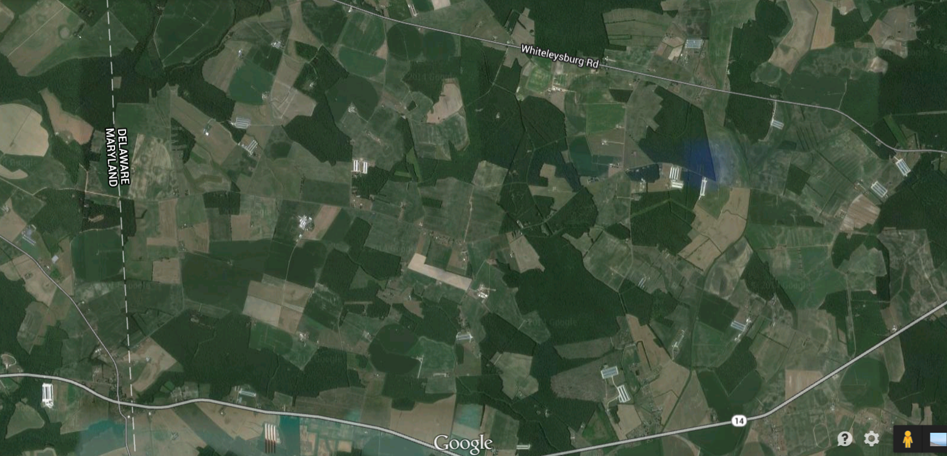
Methods:
1. Globa
Notes:
poultry houses on eastern shore.

